Slide 1

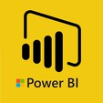
Hii,
Iam Siddhika
Welcome to Power BI Series
Part -76

Slide 2



I’m very excited to dive into this with you all!
Are you ready to enhance your data visualization skills?
We focus only on the most used and important Visuals
Today Content
VISUALIZING DATA
CUSTOM TOOLTIPS
CREATING A TOOLTIP PAGE

Slide 3


TOOLTIPS
check next slide ..
Tooltips in Power BI are small boxes that show extra information when you hover over a data point in a chart or graph.
You can create custom tooltip pages to show detailed data in an interactive and clear way.
Key Features of Tooltip Pages:
Extra Data Insights: Show more details about your data points.
Interactive: Include other visuals like charts and tables.
Customizable: Design the tooltip to match your report. Keeps Main Report Clean: Provides details without cluttering the main visuals.

Slide 4

When to Use Tooltip Pages:
Provide Additional Context: When you want to show more detailed information about a data point without overcrowding the main visualization.
Show Data Trends: To highlight trends, comparisons, or distributions related to a specific data point.
Interactive Reporting: When you want to make your report more interactive and engaging for users.
Try it out..

Slide 5
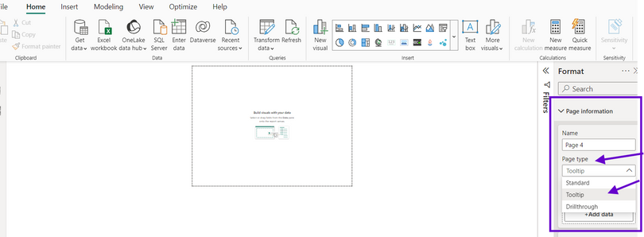
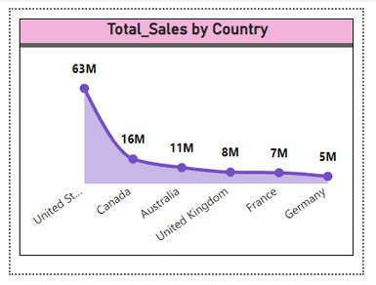
CREATING A TOOLTIP PAGE:
DO along with me guys
1. Create a new page: Set the page size to Tooltip in the page settings.
2.Design the tooltip: Add visuals like charts, tables, and images that you want to appear in the tooltip.

Slide 6
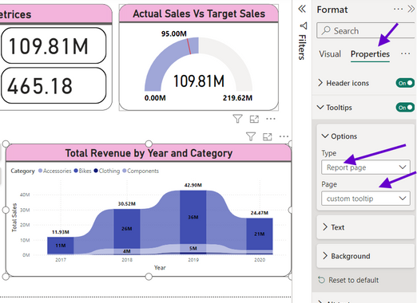

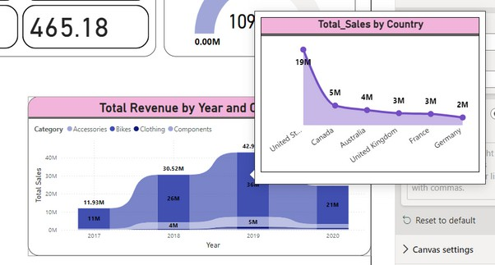

3.Enable the tooltip: Go to the main page visualization, and select the visual which you want to add tooltip.
open the format pane>Properties>Tooltips>Options>select type as Report and select your custom Tooltip page
Try it..
the visual will appear when you hover over a data point. and changes as per data point

Slide 7


Thank you for joining me today to learn about Part -76 of Power BI!
Remember, Effective data visualization is crucial for turning data into meaningful insights and compelling narratives with Power BI.
Stay tuned for more insights and tips on Power BI in our next Series.
Follow
Siddhika Shah

